Slide 1
Wipro NGA Program-LSP Batch Capstone Project Presentation- 10 July2024 Flight Booking Application Let your Dreams.. Make Fly…..!
Presented by:
Bharath Chandra Chowdary Upputuri

Slide 2
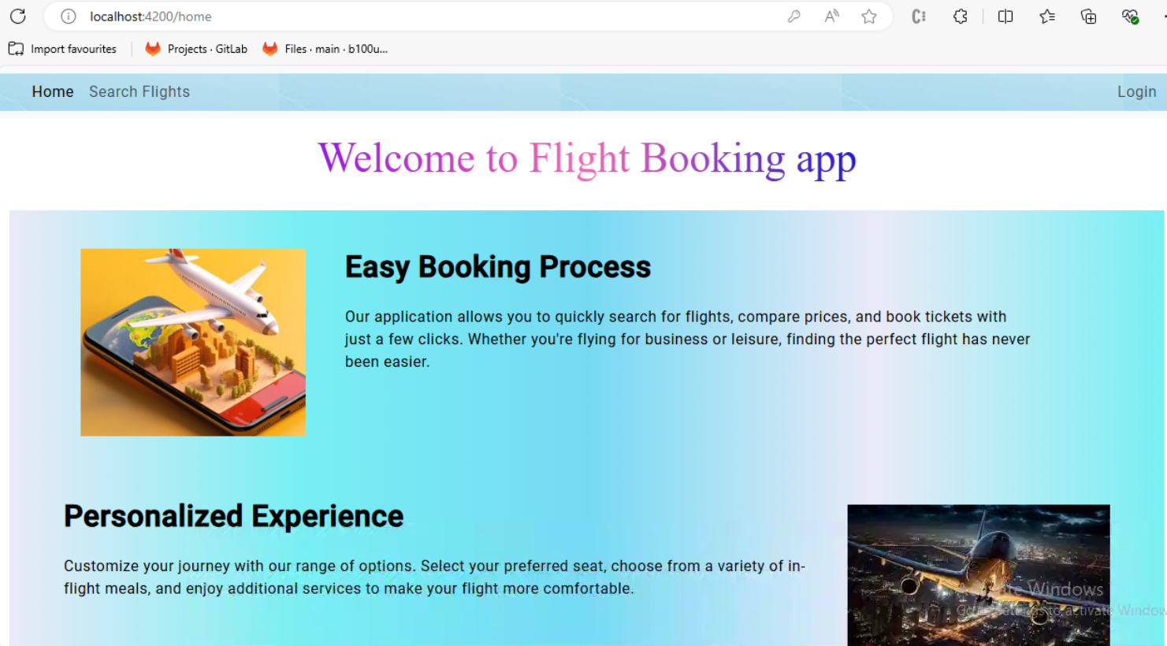

Slide 3
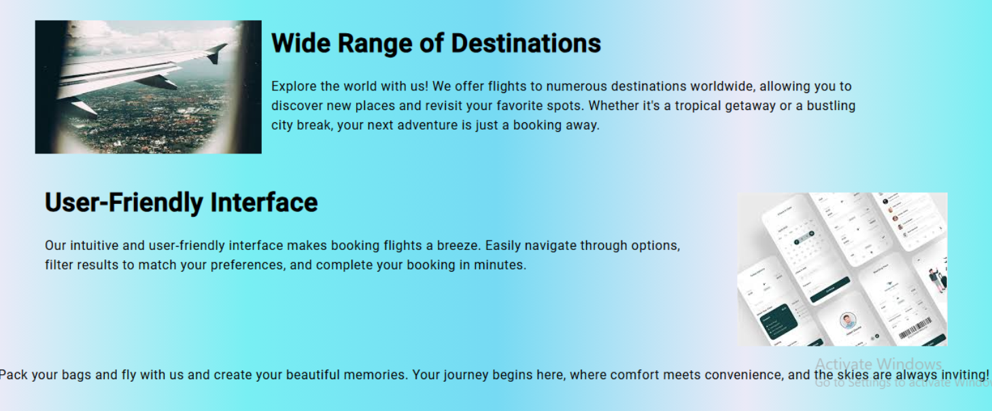

Slide 4
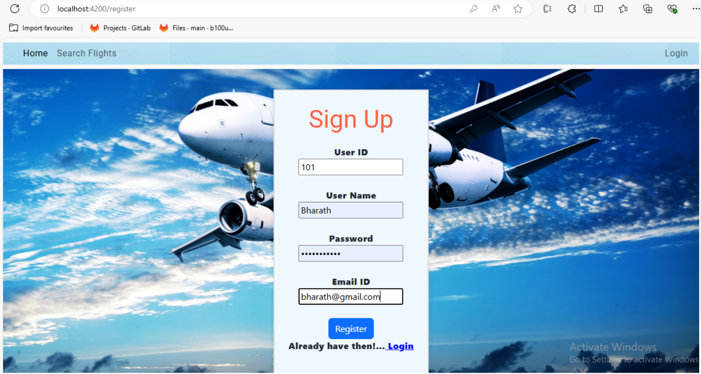

Slide 5
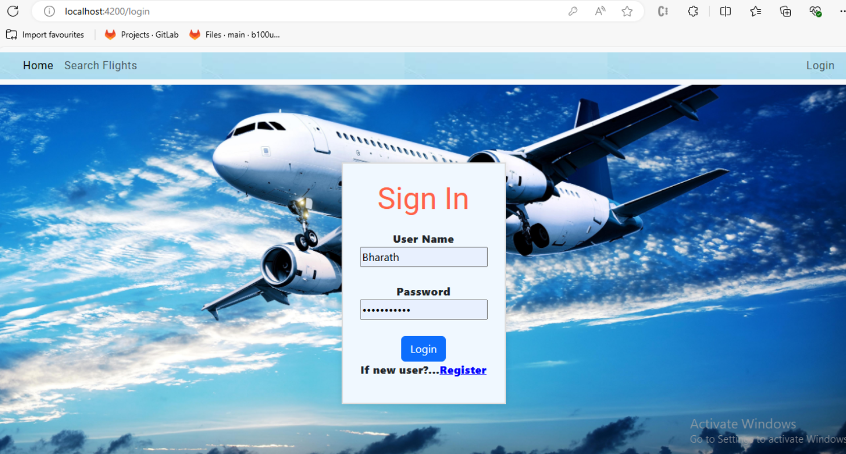

Slide 6
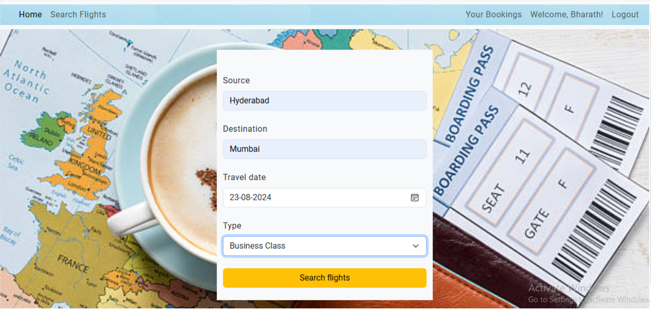
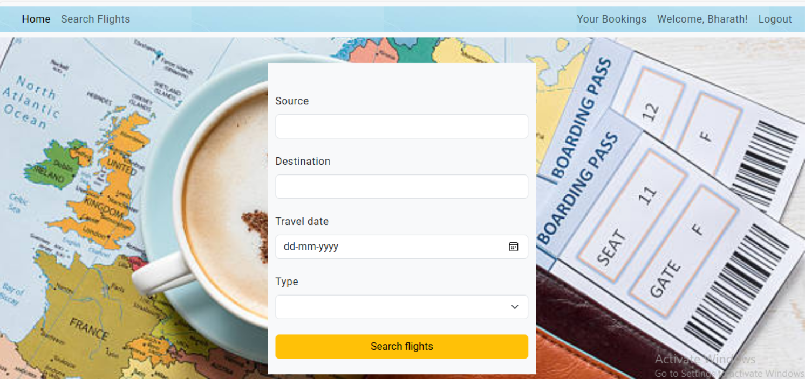

Slide 7
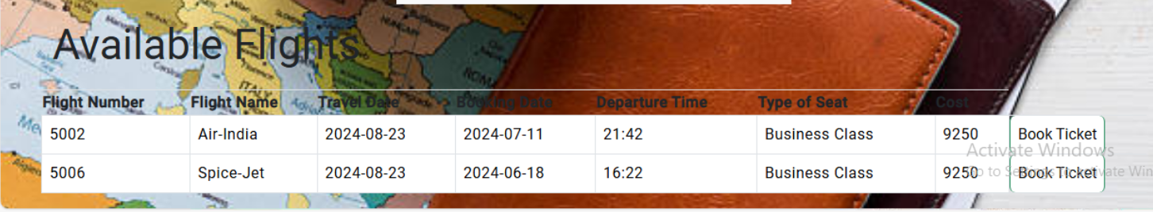

Slide 8
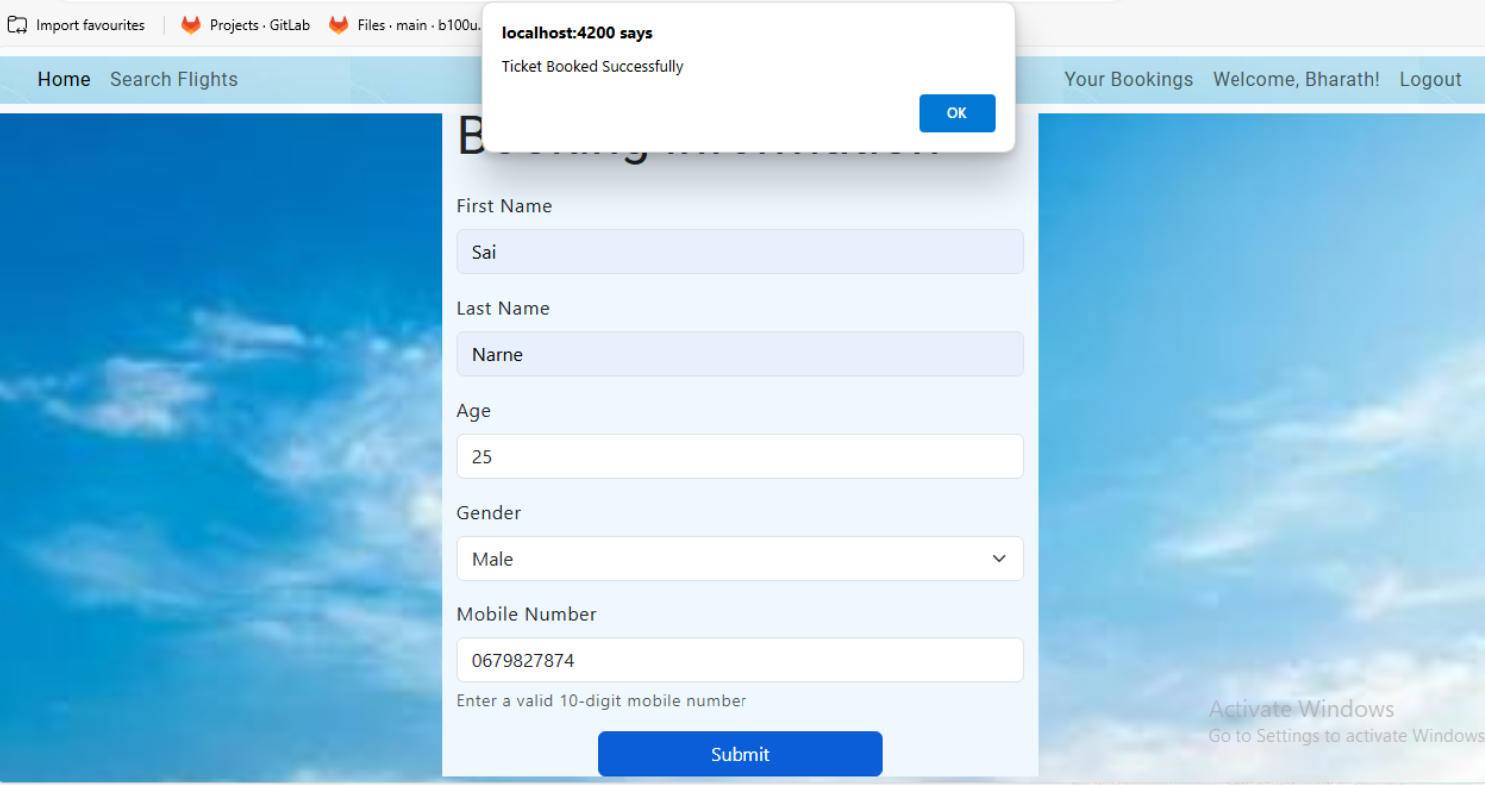

Slide 9
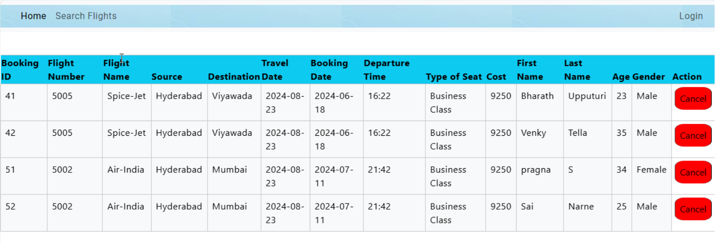

Slide 10
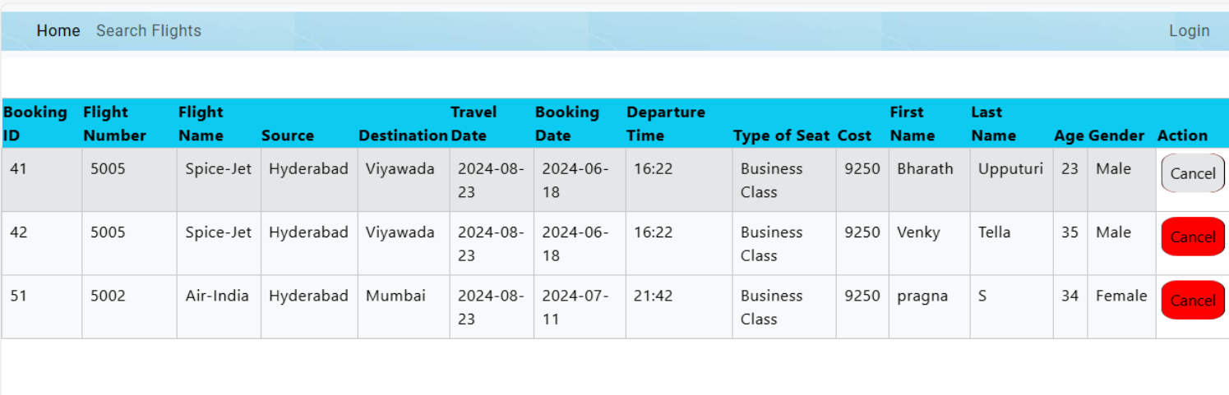

Slide 11
Thank You…!

